Slide 1
Identifying Predatory Publishers
Maha Kumaran
Maha.kumaran@usask.ca April 6, 2024

Slide 2
How to Identify Them or Warning Signs (Maybe!)
Relentless (and often meaningless) emails
URLs (Domain names)
Transparency
E.g. Publication Fees
Editorial Boards (names and email contacts)
Contact Information
Not using the right journal analytics jargon
Mimicking titles of reputable journals
Journal of Parasitology (fake)
The Journal of Parasitology (real)
Fake DOIs and ISSNs
DOIs https://www.doi.org/index.html
ISSNs https://portal.issn.org/

Slide 3
More Warning Signs (Maybe!)
Scholarly conversations about the said publisher (e.g. MDPI)
Business addresses and locations
Frequency of publication (12 issues per year!)
Peer review process
Subject areas
Literature Review

Slide 4
Example
Dear Esteemed Researcher,
We have had the pleasure of delving into your previous research available online and are excited to invite you to present your latest discoveries in our prestigious journal, "Frontiers in Life Science." Our journal serves as a platform for sharing scientific papers in various fields encompassing the humanities and natural sciences. The main goal of Frontiers in Life Science is to highlight innovative and impactful studies that challenge the current scientific knowledge. We look forward to receiving submissions that bring forth new and significant data, syntheses, or concepts in a wide range of scientific disciplines.
It is worth noting that our journal boasts an impressive five-year impact factor of 3.093, a recognition officially endorsed by Thomson Reuters. Below are some key details about our publication:
- Print ISSN: 2155-3769 - 5-year Impact Factor: 3.093 - Coverage: Science Citation Index Expanded (SCIE), Biological Abstracts, BIOSIS Previews, Essential Science Indicators - Journal Homepage: hfsp-journal . org
When visiting our journal's website, please ensure that the URL does not contain any unnecessary spaces. Instead of replying directly to this email, we kindly ask that all inquiries be directed to the journal's contact page. We encourage you to submit your paper through the provided link.
Warm regards,
Editor-in-Chief Professor Dr. GÉRALD L. BONHOMME France
Postal Address: 12-1, Quai Saint-Jean, 67000 Strasbourg, France"

Slide 5
Example
Dear Esteemed Researcher,
We have had the pleasure of delving into your previous research available online and are excited to invite you to present your latest discoveries in our prestigious journal, "Frontiers in Life Science." Our journal serves as a platform for sharing scientific papers in various fields encompassing the humanities and natural sciences. The main goal of Frontiers in Life Science is to highlight innovative and impactful studies that challenge the current scientific knowledge. We look forward to receiving submissions that bring forth new and significant data, syntheses, or concepts in a wide range of scientific disciplines.
It is worth noting that our journal boasts an impressive five-year impact factor of 3.093, a recognition officially endorsed by Thomson Reuters. Below are some key details about our publication:
- Print ISSN: 2155-3769 - 5-year Impact Factor: 3.093 - Coverage: Science Citation Index Expanded (SCIE), Biological Abstracts, BIOSIS Previews, Essential Science Indicators - Journal Homepage: hfsp-journal . org
When visiting our journal's website, please ensure that the URL does not contain any unnecessary spaces. Instead of replying directly to this email, we kindly ask that all inquiries be directed to the journal's contact page. We encourage you to submit your paper through the provided link.

Slide 6
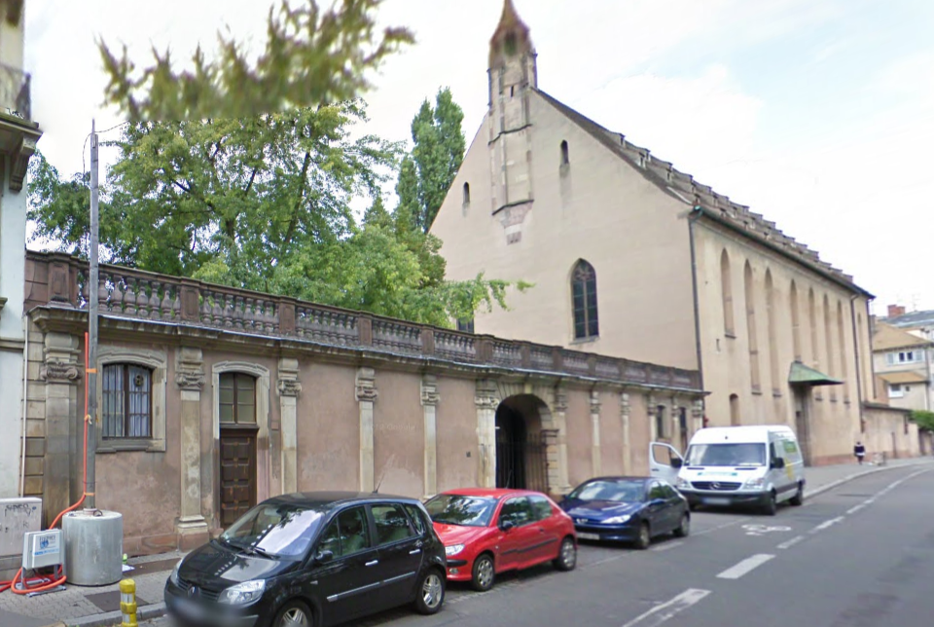
The address

Slide 7
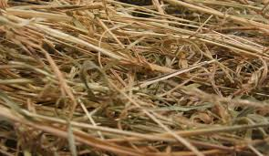
How Does It Affect You?
Your Reputation
Good scholarship is wasted
Trust in scholarship
https://commons.wikimedia.org/wiki/File:Needle_in_haystack2.jpg

Slide 8
Another Example

Slide 9
Resources to Help You
Predatory Publishers
Citation Metrics/Journal Analytics
Cabell’s Journalytics Journal Selection Policy
Journal Citation Reports (Impact Factor - Web of Science)
Sources in Scopus (Sources – SCIMago, SNIP, CiteScore)
Ulrichsweb (to check for the right URL, history, ISSN, indexing information, etc)
OPEN ACCESS
DOAJ http://doaj.org/
OASPA http://oaspa.org/
SHERPA https://www.sherpa.ac.uk/romeo/
COPE https://publicationethics.org/

Slide 10
Thank you and Contact Information
Maha.kumaran@usask.ca

